Slide 1

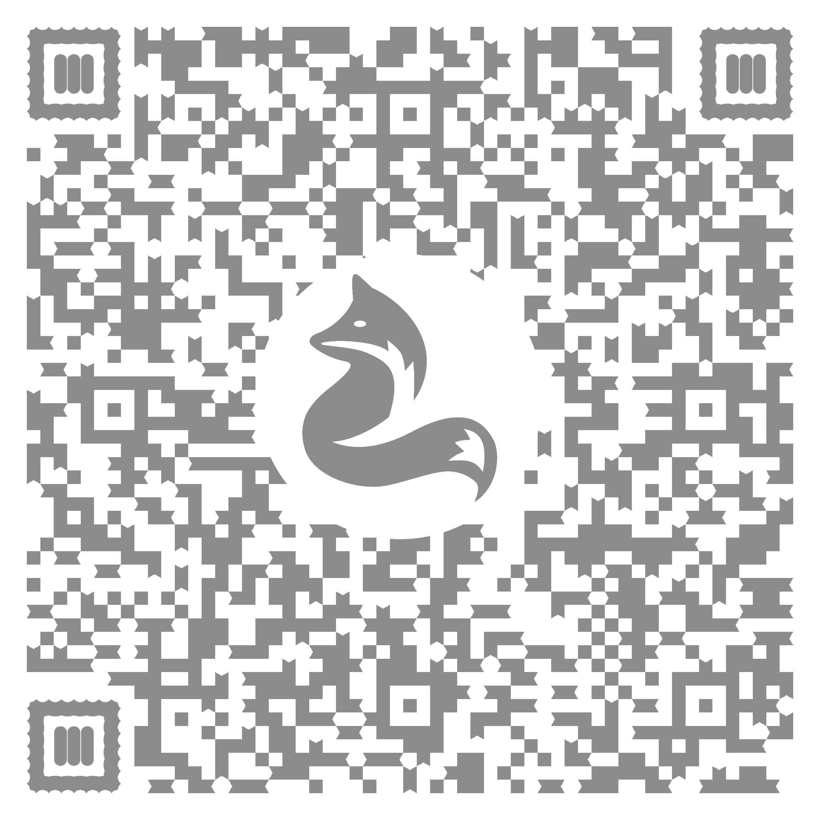

Don’t Try. Don’t Die.
Please complete the Pre-Survey!
Bruce Snodgrass, Forever 22

Slide 2
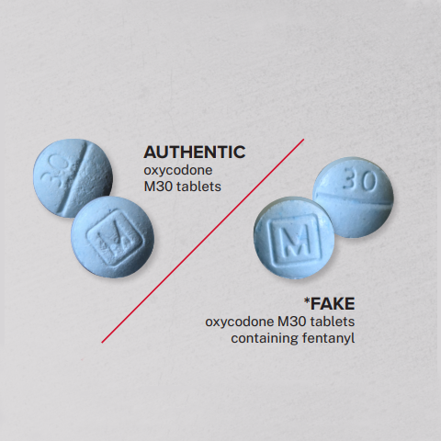
Facing the Facts
Fentanyl is a synthetic opioid that’s 50x more potent than heroin and 100x more potent than morphine
6 out of 10 fake prescription pills today contain a lethal dose of fentanyl
These pills are being sold on social media to look like Oxycontin, Percocet, Vicodin, Xanax, and stimulants like Adderall
  Assume every pill you purchase today WILL KILL YOU

Slide 3
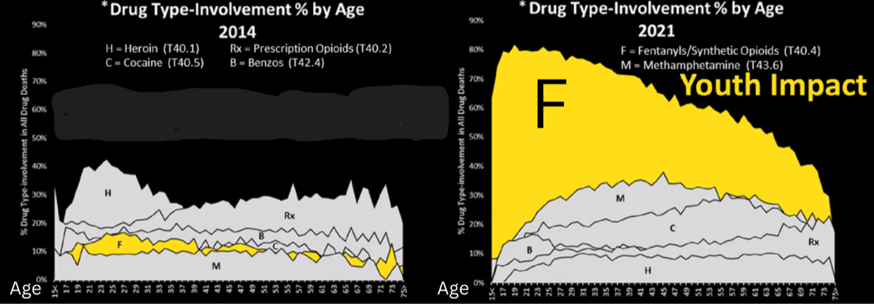
Trends

Slide 4
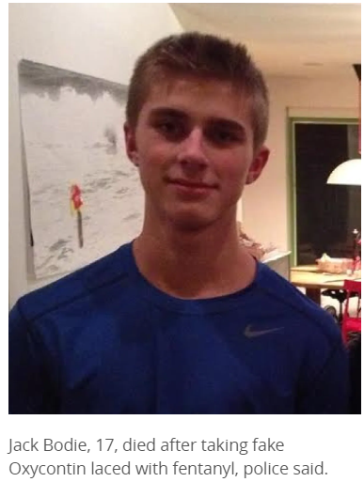
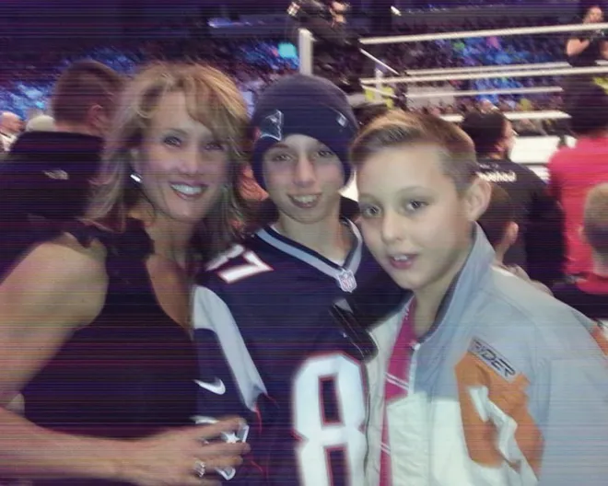
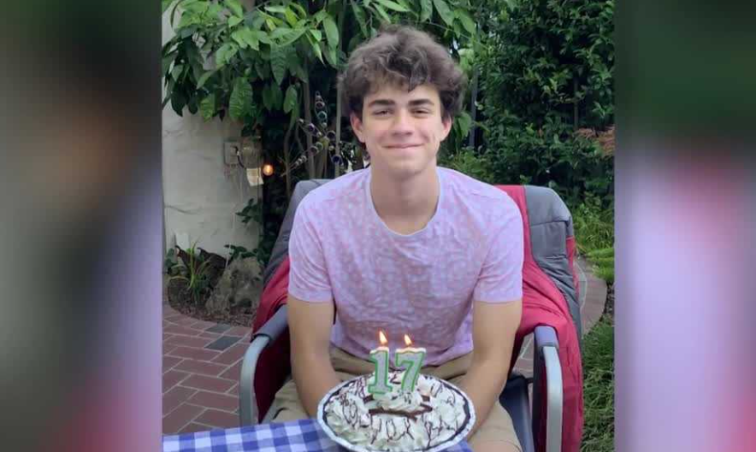
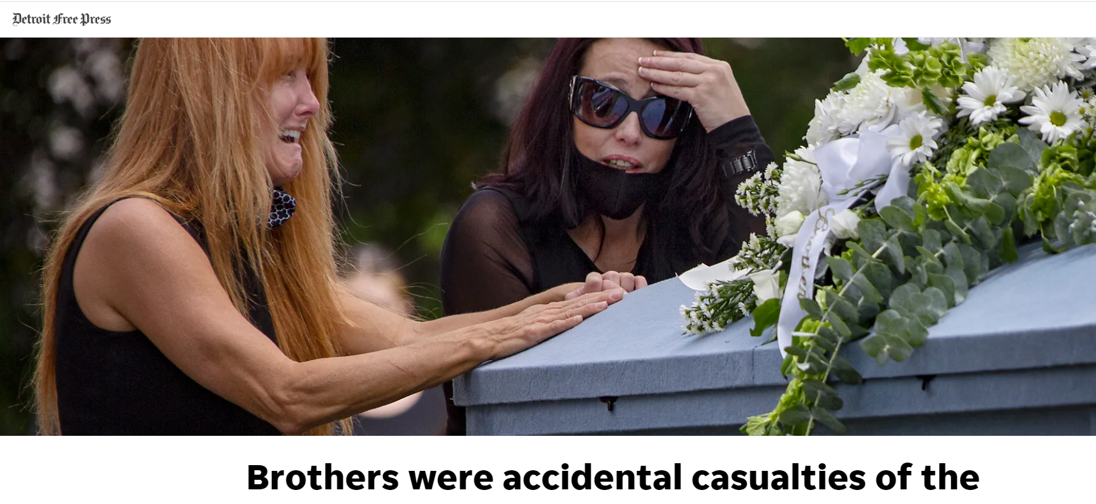
News
DON’T BECOME A HEADLINE!
“Brothers Caleb (18) & Kyler (20) Kiessling, Poisoned by fentanyl thinking it was Percocet”
Michigan
California
Vancouver
Zachary Didier (17) straight “A” honors student, athlete in soccer and track, and a musician accepted into Stanford and UCLA. Poisoned by fentanyl thinking it was Percocet

Slide 5
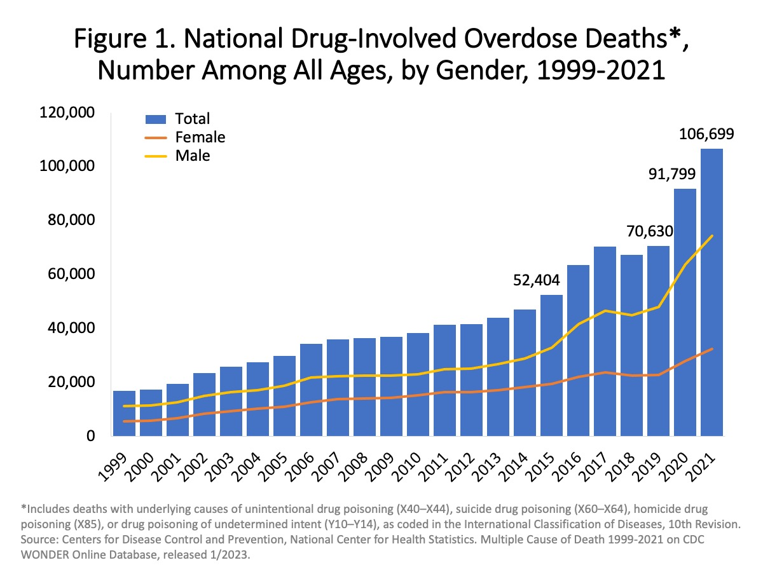
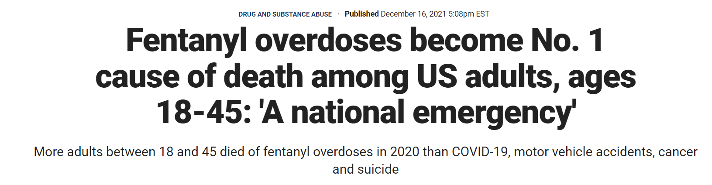
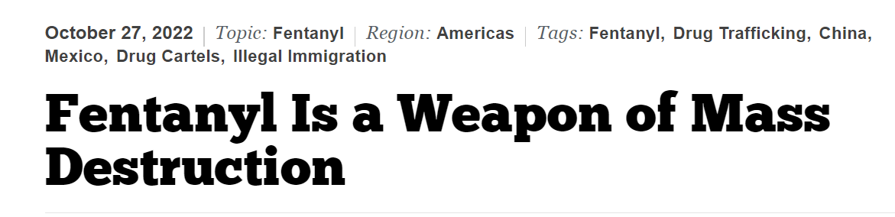
Trends
82% of all opioid-involved deaths in 2020 - FENTANYL.
In 2022, 110,315 deaths
FENTANYL is slaughtering an entire generation…

Slide 6
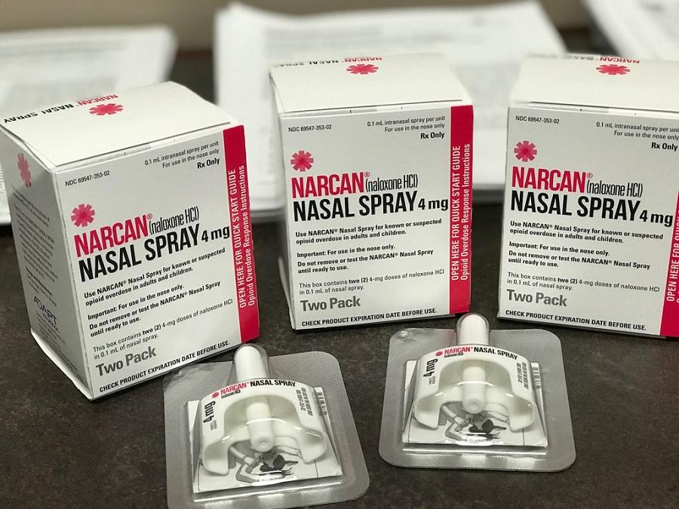
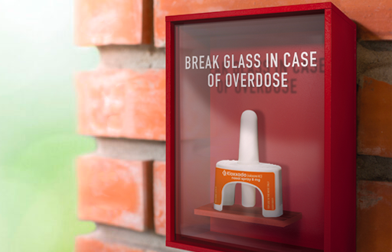
Naloxone
Life saving medication that reverses the effects of an opioid overdose
Should be kept in every household like a first aid kit or an EpiPen
Use if signs of an overdose…
  Small, constricted “pinpoint pupils”
  Falling asleep or losing consciousness
  Slow, weak, or no breathing
  Choking or gurgling sounds
  Limp body
  Cold and/or clammy skin
  Discolored blue skin (especially in lips and nails)
Safe for all ages and NO contraindications for use
Ask a pharmacist, non-profit, or Fentanyl Fathers to get Naloxone for your home

Slide 7
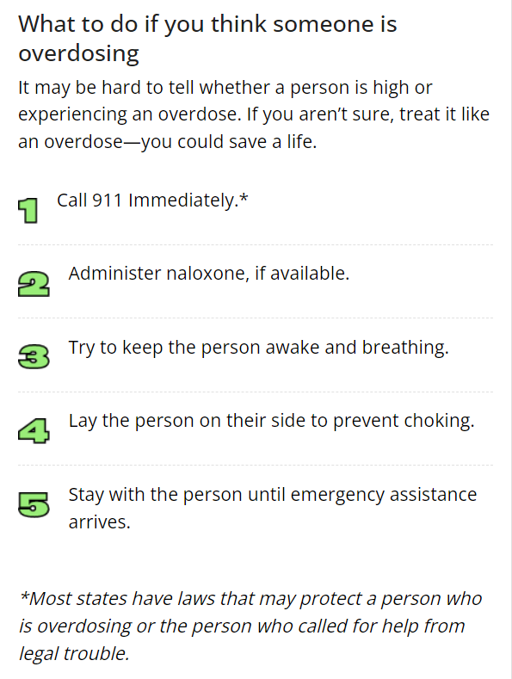
Good Samaritan Law
Prevents drug possession charges against those that seek medical assistance for an overdose.
This law makes saving lives the priority during a drug overdose, not criminal prosecutions of illegal drug users
SAVING A LIFE is more important than SAVING A FRIENDSHIP
  If you see something SAY SOMETHING

Slide 8
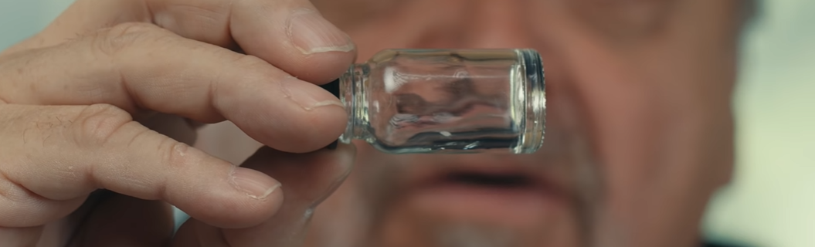
“Dead on Arrival”
https://www.youtube.com/watch?v=iJgPmrLjkuo&t=407s
“It’s odorless, it’s tasteless, and you don’t know it’s there…and when you find out it’s there it’s too late…you’ll be dead.”

Slide 9
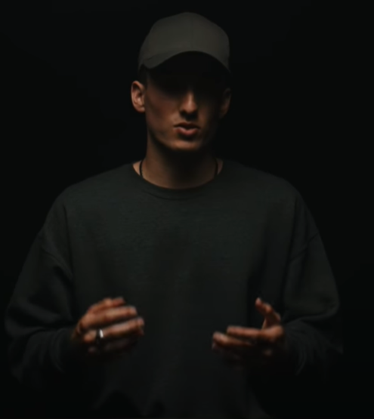
Q & A

Slide 10
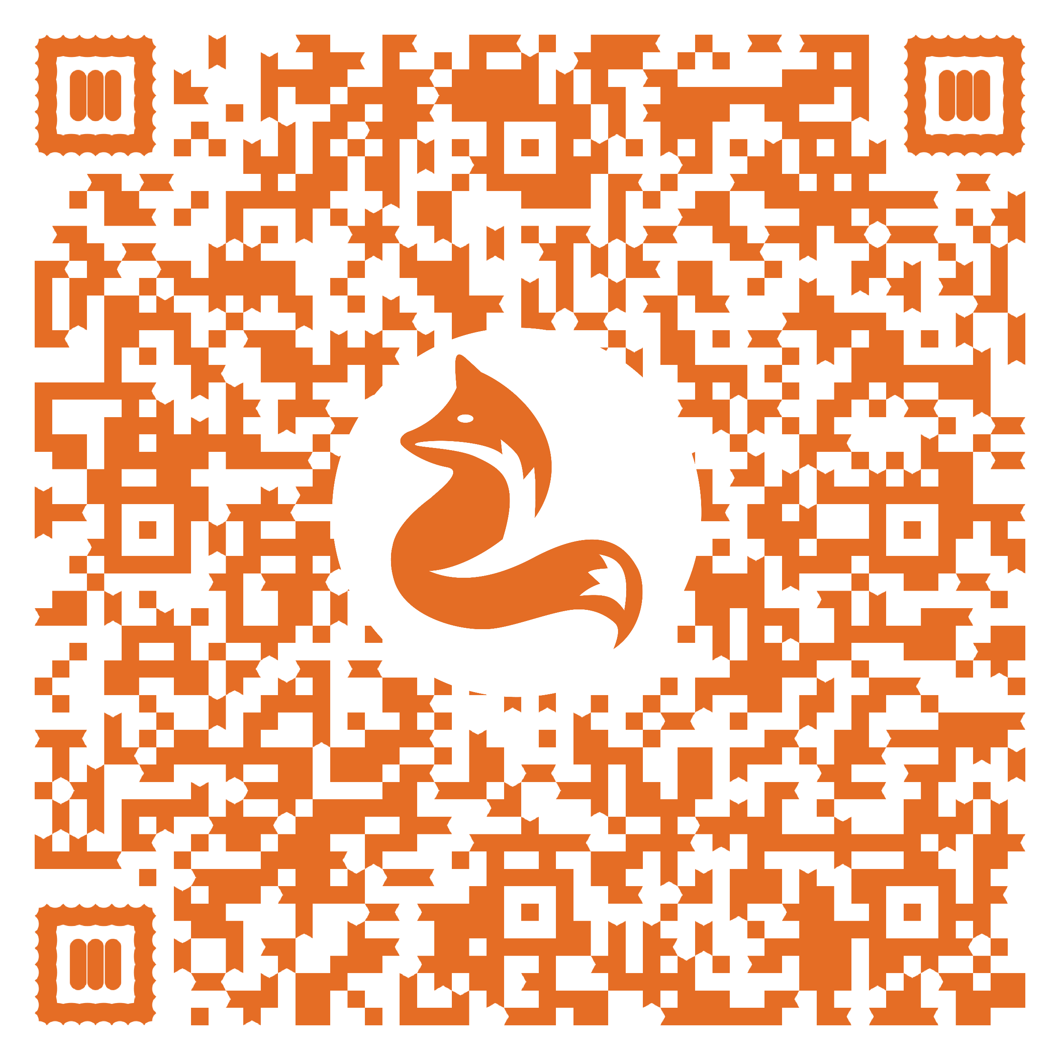
Please complete the survey!
Don’t Try. Don’t Die.

