Slide 1
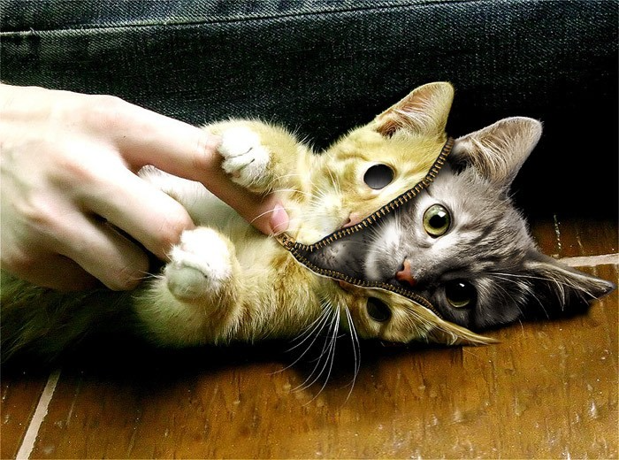

101 Ways to Skin The Cat
How to Get INTO High Schools to Present about Fentanyl

Slide 2


Slide 3


Slide 4

Accept the Front Door Is Dead Bolted
Rookies and Amateurs always try the front door first.
“And acceptance is the answer to all my problems today. When I am disturbed, it is because I find some person, place, thing or situation - some fact of my life - unacceptable to me. I can find no serenity until I accept that person, place, thing or situation as being exactly the way it is supposed to be at this moment.”

Slide 5
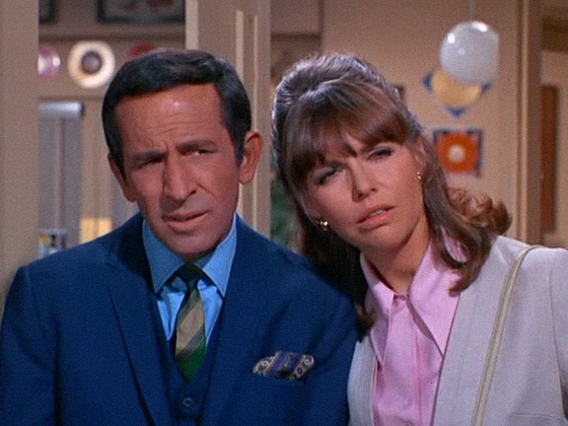
Get Smart

Slide 6



Accept you are no longer a bereaved parent. You are a Salesperson. The Good News is - you’ll be successful. - Zig Ziglar Quote on why “Introverts outsell extroverts 100 out of 100 times.”
“Bereaved Parents are a Force of Nature” - Dr. Snodgrass
“No bereaved Parent gets near my door.” - Nancy Pelosi
3 Recommended Books

Slide 7

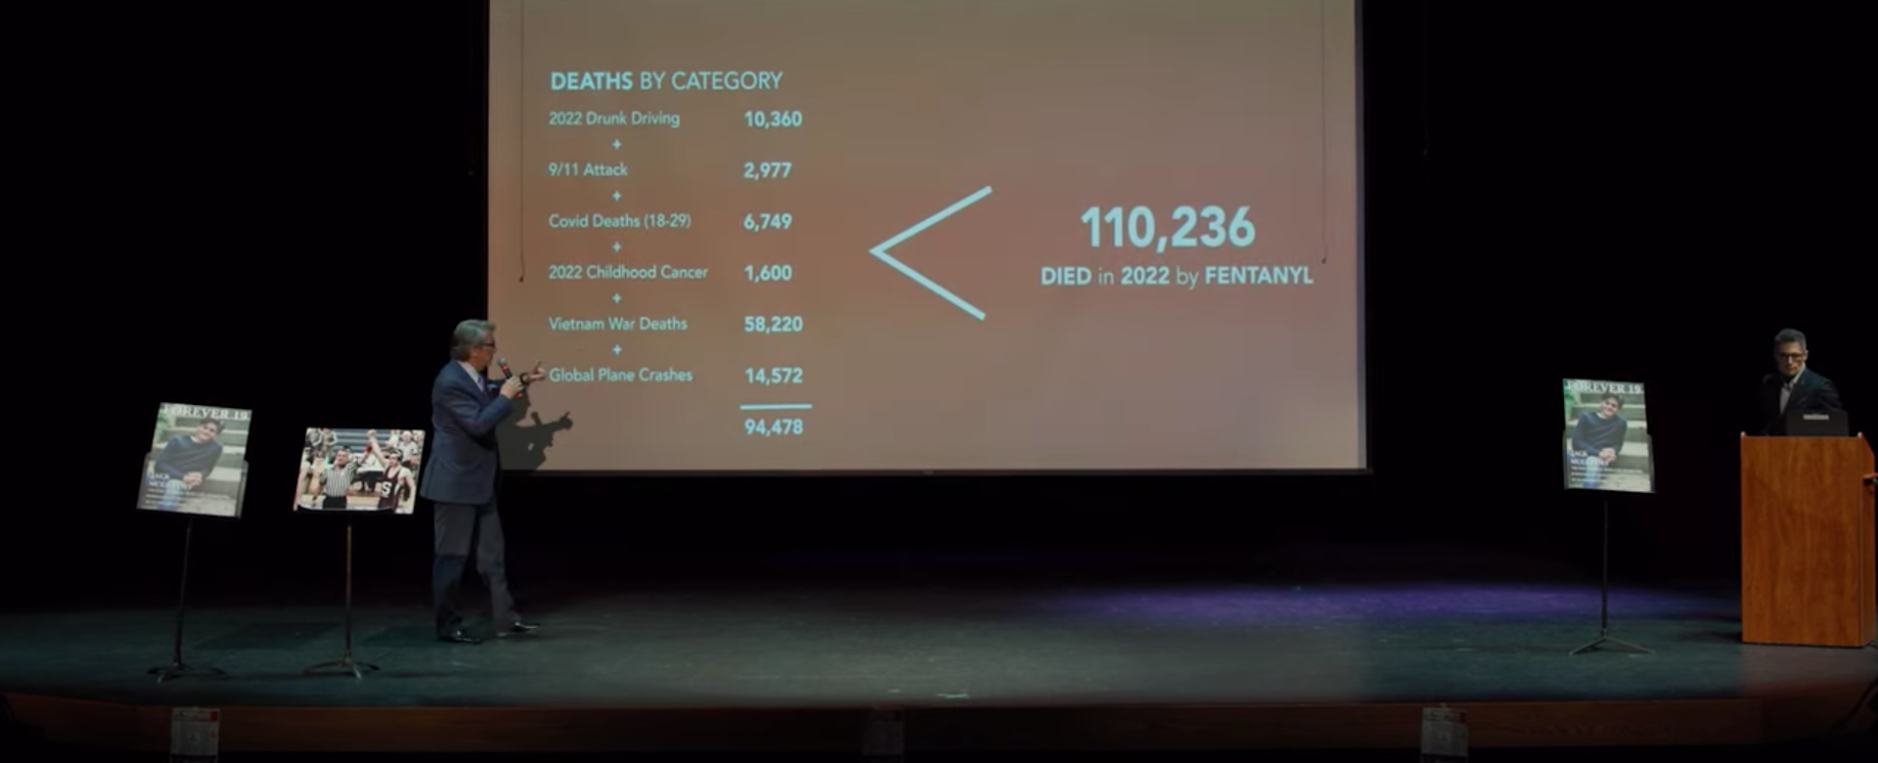
The SIDE Door
The Health Care Teacher - The Seaholm Story

Slide 8
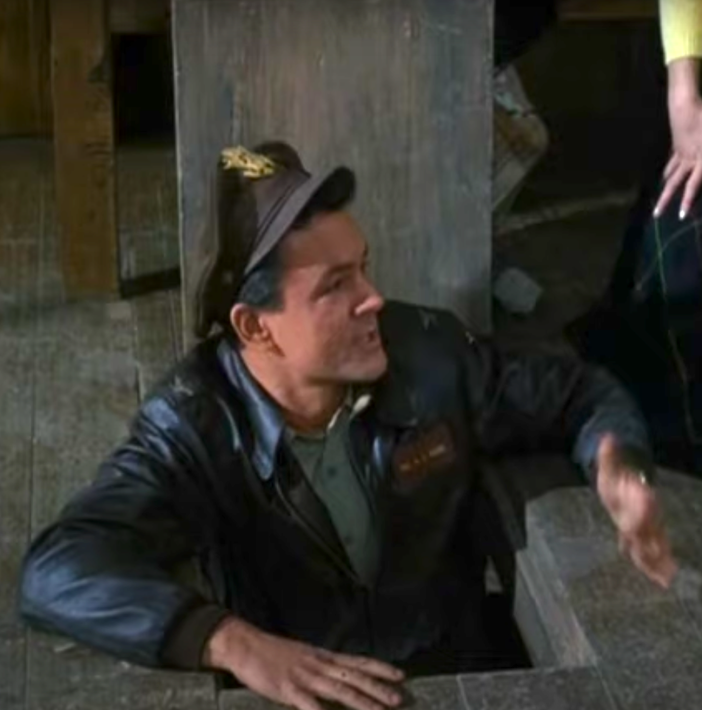
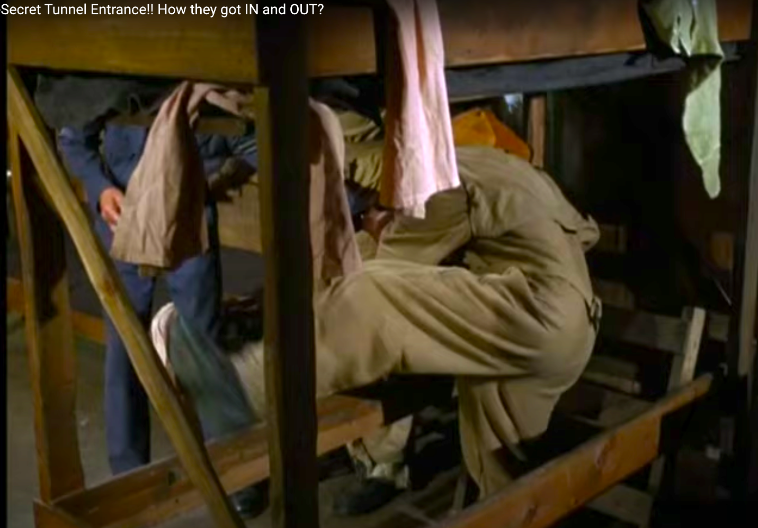
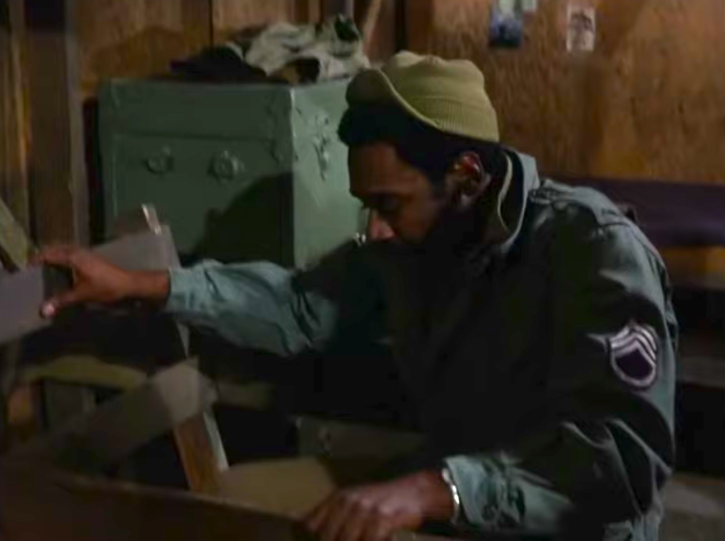
Secret Tunnel Entrance

Slide 9
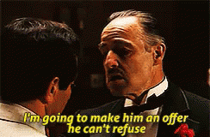

Slide 10

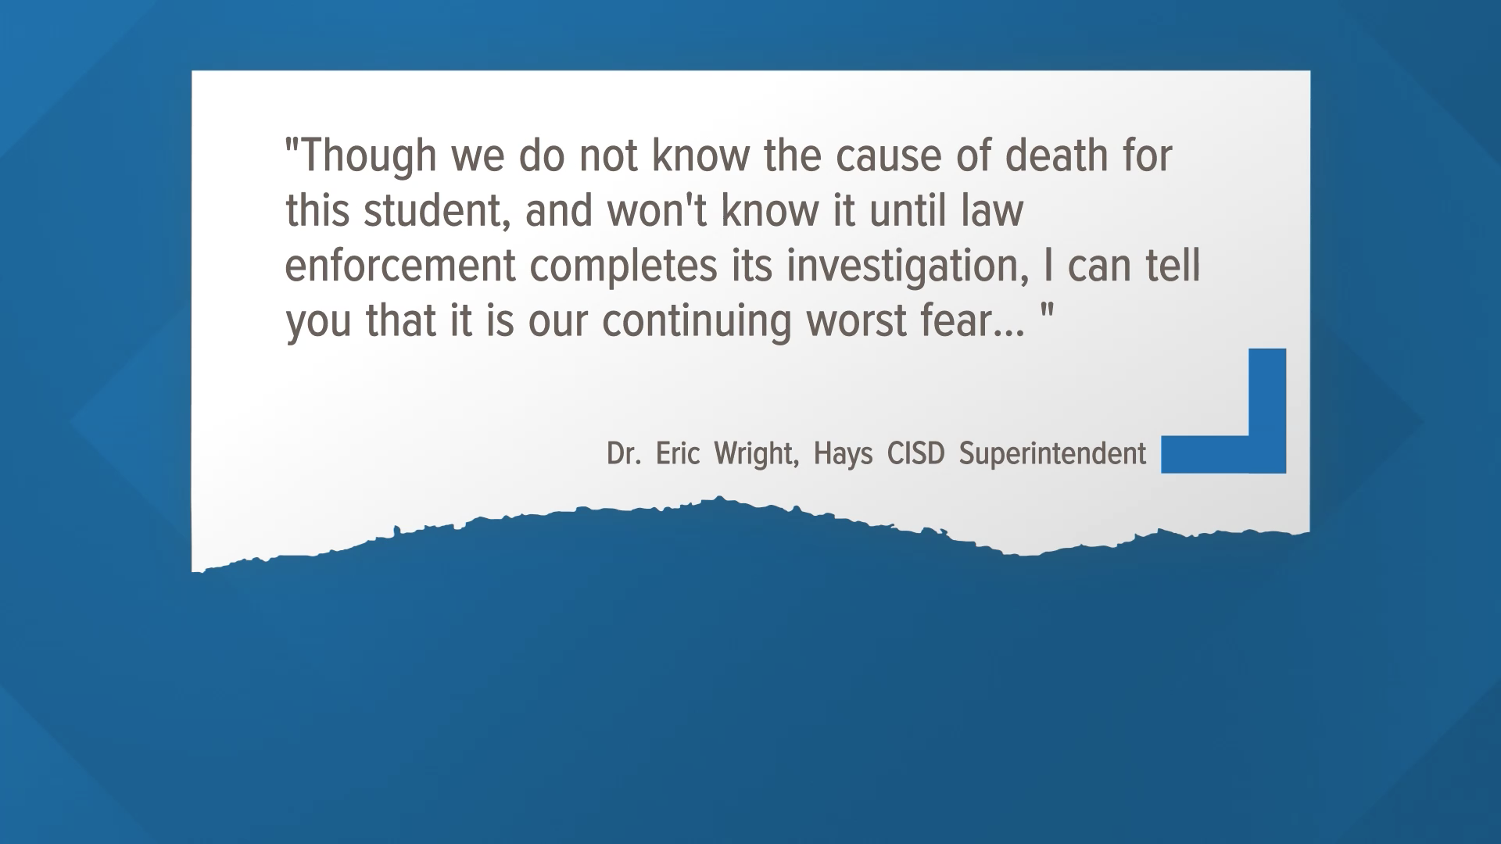
Top Down Method

Slide 11
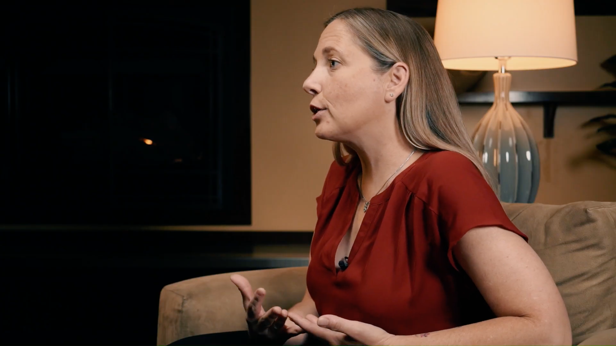
The Amy Neville Method

Slide 12
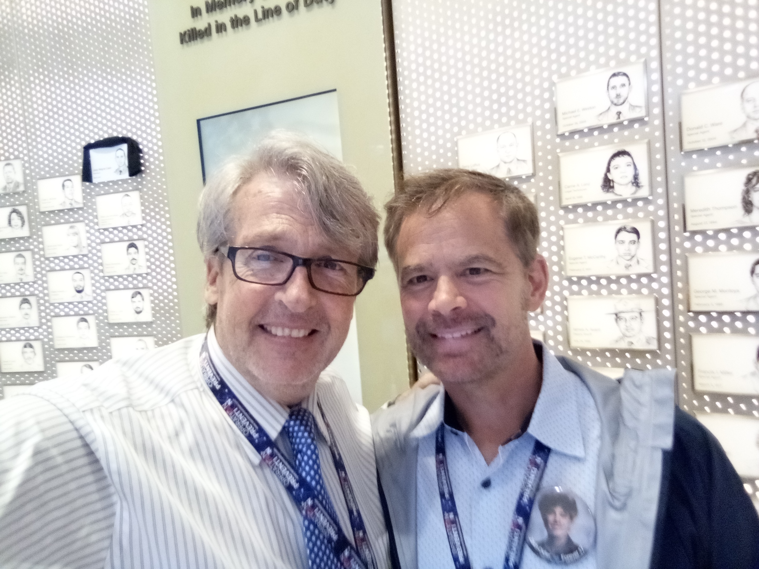
The Chris Diddier Method

Slide 13
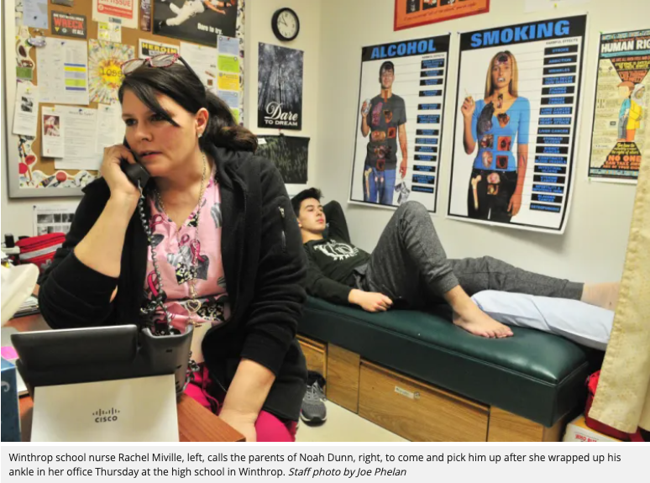
The Screen Door

Slide 14
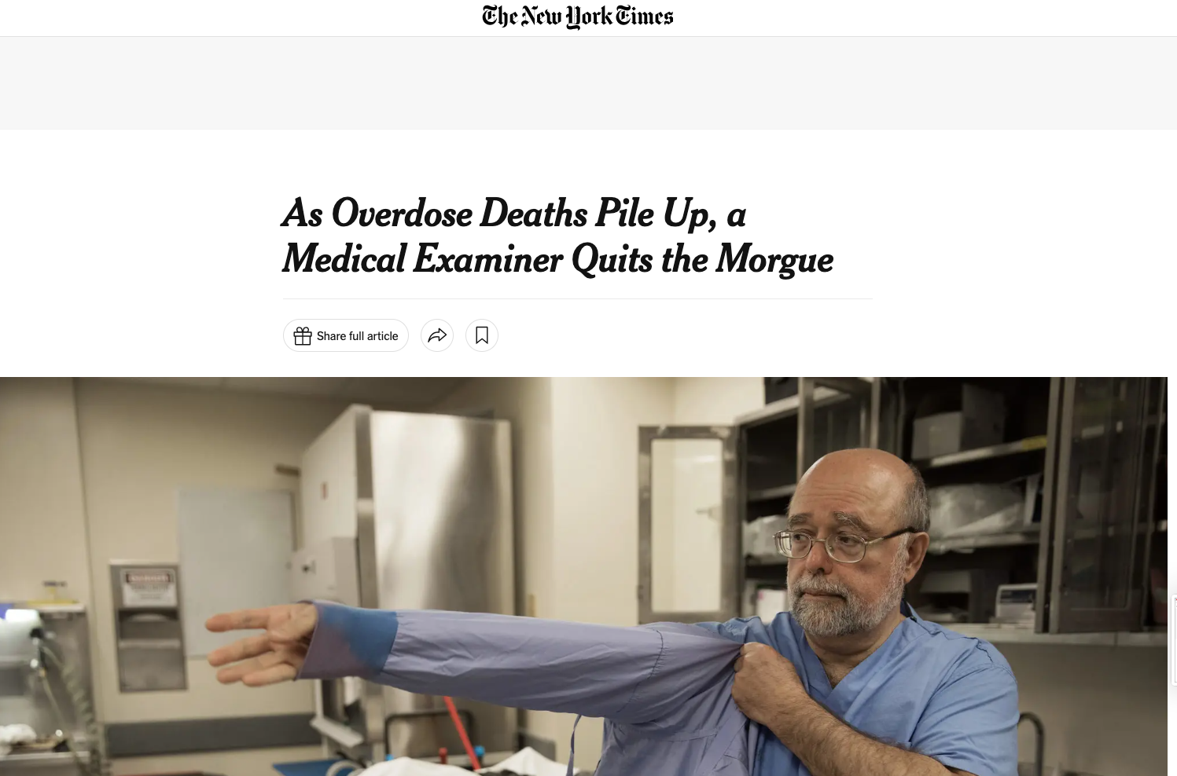

Slide 15


Slide 16


Slide 17


Slide 18


Slide 19


Greg Swan
248 667 2722
Greg@FentanylFathers.org

